Slide 1
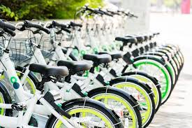
Analysis of Seoul Bike Rental Demand
Project Type: EDA
Presented by: Sharayu Jagtap
GUIDE BY: ABHISHEK WAHWAL

Slide 2
Project Summary
The project analyzes bike rental data to understand factors affecting demand
The dataset contains 8760 observations and 14 variables, representing hourly data for one year
Various visualization techniques like line charts, bar charts, scatter plots, heatmaps, histogram, and KDE plots were used
Bike rentals are highly influenced by temperature, season, and time of day
Rentals increase during warm weather and summer season
Rentals decrease during rainfall, snowfall, and winter season
A clear daily pattern is observed with peak demand in morning and evening hours
Most rental values are low to moderate, with few extreme high values
The analysis helps in better planning of bike availability and resource management

Slide 3
Objectives
To analyze the number of bikes rented per hour and per month
To study the effect of weather variables such as temperature, humidity, wind speed, rainfall, snowfall, solar radiation, and dew point temperature
To examine the impact of time variables (date and hour)
To analyze seasonal variation in bike rentals
To compare rentals on holidays and non-holidays
To study the effect of functioning and non-functioning days
To analyze relationships using heatmap
To study distribution using KDE plot
To identify key factors influencing bike demand

Slide 4
Data Description
The dataset contains 8760 rows and 14 variables.
The dataset includes both numerical and categorical variables.
The dataset contains the following variables:
Date → Day of observation
Hour → Time of the day
Rented Bike Count → Number of bikes rented
Temperature → Weather temperature
Humidity → Moisture in air
Wind Speed → Speed of wind
Visibility → Clarity of atmosphere

Slide 5
Dew Point Temperature → Moisture indicator
Solar Radiation → Sunlight intensity
Rainfall → Amount of rain
Snowfall → Amount of snow
Seasons → Seasonal category
Holiday → Holiday or not
Functioning Day → Whether system is working

Slide 6
Data Cleaning
Checked duplicate values.
Checked Null values.
Converted date column in datetime data type.
Removed unwanted space and replace with “_” sign in column names.
Data Transformation
Added a primary key.
Added a new column Day_Night on the basis of solar_radiation

Slide 7
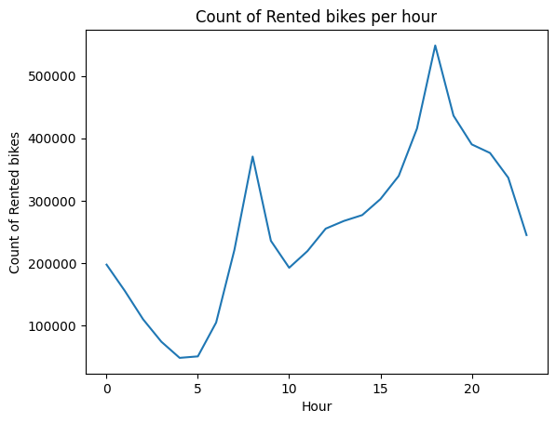
1. Count of rental bikes per hour
This chart is created to understand how bike rental demand changes at different hours of the day. It helps to identify peak hours (high demand) and low-demand periods.
There is a morning peak around 8:00 AM, which represents office-going time
The highest demand occurs at 6:00 PM (18:00) when people return home
The lowest rentals are observed between 4:00 AM and 5:00 AM, when most people are inactive
Evening rentals are higher than morning rentals, indicating stronger demand in the evening
Business Solution :
Ensure more bikes are available before peak hours (morning and evening)
Perform maintenance during low-demand hours (2:00 AM to 5:00 AM)
Increase bike availability and staff during evening peak (6 PM)

Slide 8
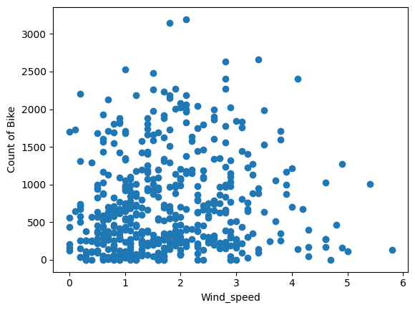
2. Scatterplot of Wind speed and count of bikes
This chart is used to understand how wind speed affects bike rental demand and to see whether users prefer renting bikes in low or high wind conditions.
Most bike rentals occur when wind speed is low (0–3 m/s)
As wind speed increases, the number of rentals gradually decreases
When wind speed exceeds 4 m/s, rentals drop significantly
Very few users rent bikes at high wind speeds (above 5 m/s)
Business Solution
Schedule maintenance activities during high wind conditions, as demand is already low
No need to keep excess bikes available when wind speed is high
Focus more availability during low wind conditions, when demand is higher

Slide 9
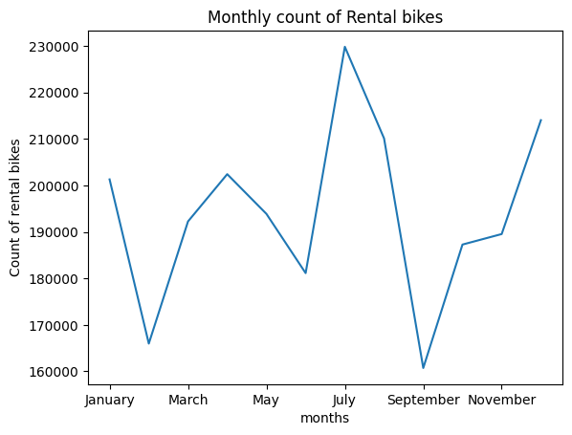
3 Monthly count of Rental Bikes
The highest demand is observed in July, indicating peak usage
Another high demand is seen in December
The lowest rentals occur in February and September
This shows that bike usage changes significantly across different months
Business Solution
Plan maintenance and repairs during low-demand months (February and September)
Use low-demand periods to improve service efficiency and reduce operational load
Focus on maintaining consistent service in important locations throughout the year

Slide 10
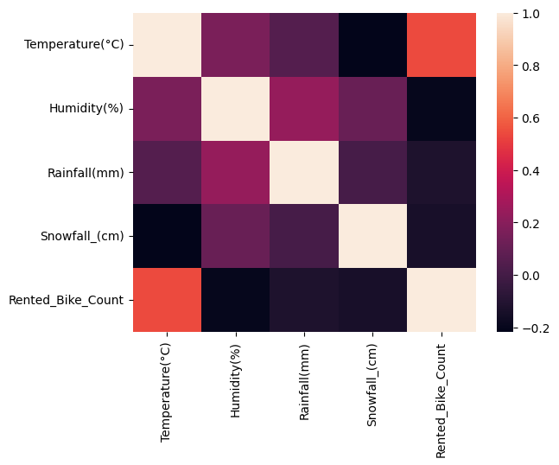
4.Correlation Between Weather Variables and Bike Rental Count

Slide 11
This heatmap is used to understand how different weather variables are related to bike rentals and to identify which factor affects demand the most.
The heatmap shows relationships using colors:
Temperature has a strong positive relationship
👉 When temperature increases → bike rentals increase
Rainfall and Snowfall have negative relationships
👉 When rain or snow increases → bike rentals decrease
👉 This means:
Good weather → more rentals
Bad weather → fewer rentals

Slide 12
Business Solution
Use weather forecasts to plan bike distribution in advance, placing more bikes in high-demand areas on warm days
During rain and snowfall, reduce redistribution efforts and focus on essential operations only
Monitor temperature changes daily to adjust fleet availability dynamically
Focus on maintaining service in key locations (metro stations, offices) even in bad weather

Slide 13
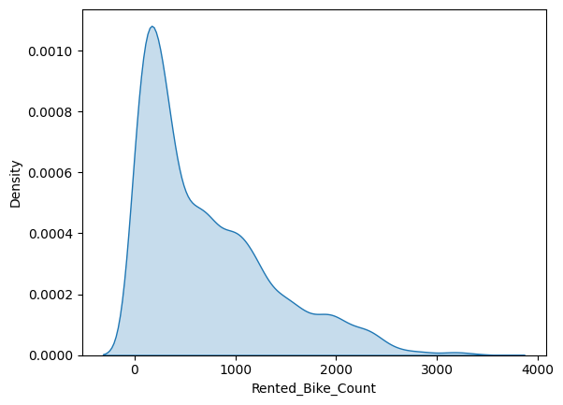
This KDE (Kernel Density Estimation) plot is used to understand the distribution of rented bike count. It provides a smooth curve to show how frequently different rental helps in identifying the overall pattern of the data.
5. Frequency curve of Rented bike count
The plot shows that the data is positively skewed (right-skewed):
Most of the bike rentals are concentrated in the low range (0–500)
Moderate rental values occur occasionally
Very high rentals (above 2000) are rare
The curve has a long tail towards the right, indicating fewer high-value observations

Slide 14
Business Solution
Maintain a base number of bikes to handle regular low-to-medium demand
Avoid over-allocation of bikes since high demand occurs less frequently
Use flexible or dynamic planning to handle peak demand when required
Focus on efficient management of daily operations rather than only extreme cases

Slide 15
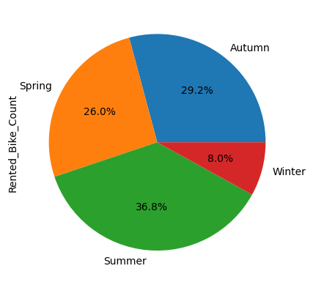
6.Seasonwise total count of rented bike
Bike rentals are highest in summer
Moderate rentals in autumn and spring
Lowest rentals in winter
Shows strong impact of season on demand
Business Solution
Ensure high bike availability during summer in major demand areas
During winter, limit operations to key locations to reduce costs
Use low-demand periods for maintenance and system improvements
Plan resources seasonally for better efficiency

Slide 16
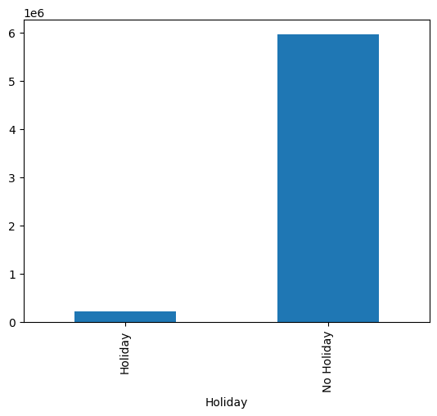
7. Bike Rentals on Holidays vs Non-Holidays
Rentals are much higher on non-holidays
Very low rentals on holidays
Indicates rentals depend on daily routine (work/college)
Business Solution
Focus bike availability near offices and public transport on working days
Reduce operations during holidays
Optimize resource usage based on demand

Slide 17
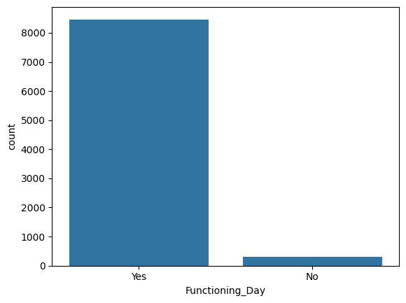
8.Bike Rentals on Functioning vs Non-Functioning Days
Most days are functioning days
Very few non-functioning days
System is generally reliable
Business Solution
Maintain system regularly to ensure continuous service
Reduce non-functioning days to avoid loss of revenue
Monitor system performance for better efficiency

Slide 18
Conclusion
Bike rental demand is strongly influenced by weather conditions, time, and seasons
Rentals increase during high temperatures and summer season
Rentals decrease during rainfall, snowfall, and winter season
There is a clear daily pattern, with peak demand in morning and evening hours
Most rental values are low to moderate, while very high demand occurs rarely
Temperature, time of day, and season are the key factors affecting bike rentals
These insights help in better planning of bike availability and resource management

